Slide 1
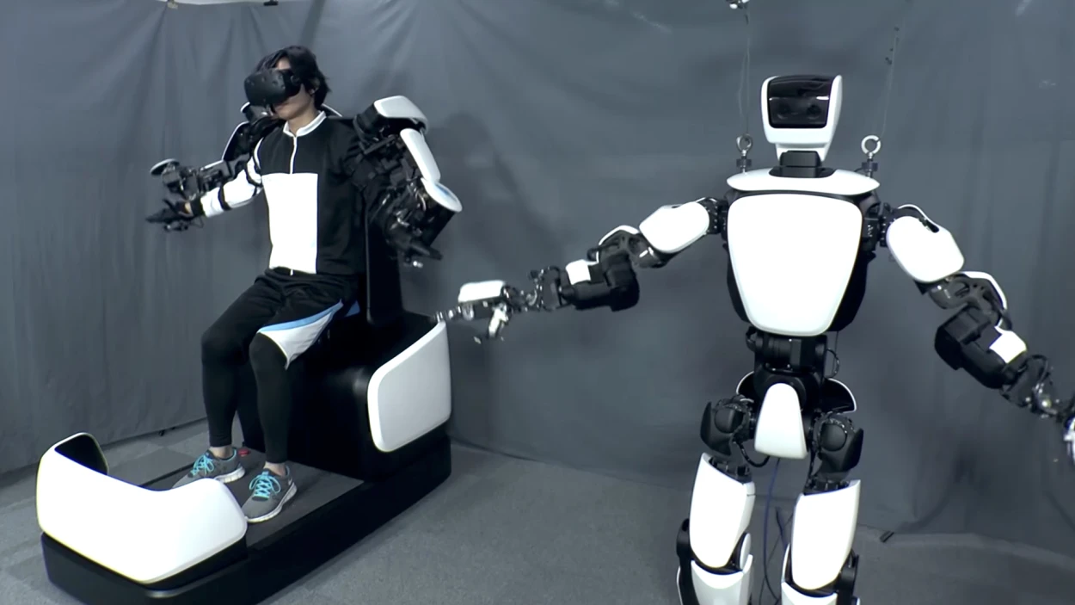
Avatar robots in border security using 5g technology

Slide 2
What is the problem
What is the solution step by step
How the jacket having sensor which will be try to control the robot
Connection between the robot and the sensor jacket
Impact of technology implemented with military robot
Economic with respect to human life and comparision with robots

Slide 3

introduction
The technology seeks to provide seamless coverage, high data rate, low latency and highly reliable communications system.
5G services are also expected to play a major role to achieve the economic goal of making India a $5-trillion economy by 2024-25.
According to experts, 5G will have a cumulative economic impact of $1 trillion by 2035 and can deliver an additional GDP of $150 billion for the country, between 2025-40.

Slide 4
How 5g could help in powering digital india
1. Democratising education
2. Reliable healthcare
3. Smart agriculture
4. Enable Industry 4.0
5. Smart Cities and Smart Homes
6. Lag-free gaming and entertainment
7. New business models
8. Security purpose

Slide 5
Problems in border security
And while issues of security from terrorist attacks is certainly a major concern that drives many border security considerations, there are other critical, “daily” issues involving criminal activities, including trafficking in drugs, the smuggling of weapons and other illegal contraband, and human trafficking
Sections of the boundaries are unsettle.
Terrains are diverse and difficult.
Border areas are underdeveloped.
Connectivity with the hinterland and across to other countries is poor.
Border populations feel insecure.
Borders areas in remote parts are getting depopulated.
Illegal migrations, which alter demographic ratios, present a major challenge.
The smuggling of contrabands, arms and ammunition drugs etc is rampant.

Slide 6
Solutions using dog robots
The robot dogs are manufactured by Ghost Robotics, a security tech company that works with the military.
The plan is for the machines to patrol the border, videoing and scanning around them as they go.
This has led to privacy concerns about the surveillance of those who live near the border without consent.

Slide 10
How can robots help the society especially in economic and in the life of human
Robots eliminate dangerous jobs for humans because they are capable of working in hazardous environments. They can handle lifting heavy loads, toxic substances and repetitive tasks

